Slide 1
Professionalism in IT: Attire, Behavior, and Best Practices for Success
Michael Sullivan
Purdue University Global
CS212 Communicating Professionalism
09/03/2024

Slide 2
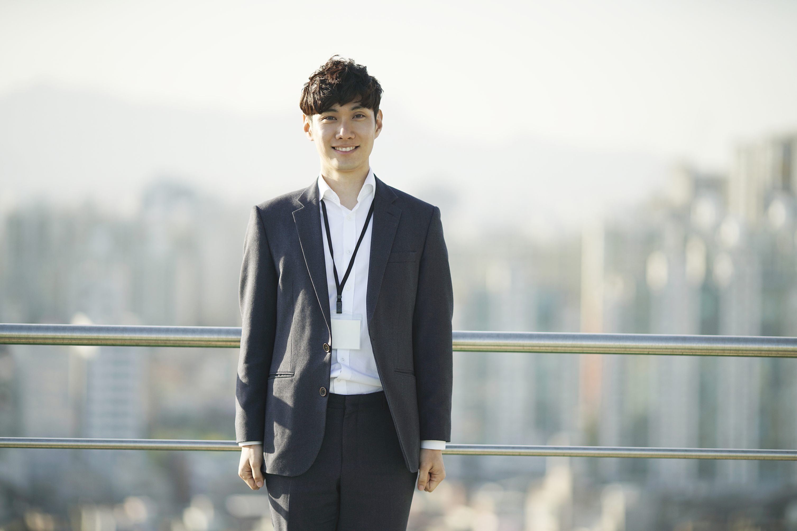

Professional Attire in Information Technology
Notes:
Business Casual Attire
Business casual attire is widely accepted in the IT industry and typically includes a collared shirt, slacks, and dress shoes. According to IT Career Lab (2018), this attire balances professionalism with comfort, making it suitable for the long hours often required in IT roles. It conveys a polished appearance, which is crucial in client-facing situations and helps to establish credibility.
Smart Casual Attire
The IT field also accepts smart casual attire, which can include wearing a blazer with dark jeans and loafers. Smith and Doe (2023) highlight this attire's appropriateness in contemporary tech environments, where a more relaxed yet professional appearance is desired. Even in the fast-paced, innovative world of IT, smart casuals let people in the profession eschew the "unapproachable nerd" stereotype, while still allowing them to look respectable.

Slide 3


Unprofessional Attire in Information Technology
Notes:
Casual or Untidy Clothing
In most IT environments, informal or unkempt clothing—like a wrinkled T-shirt and jeans—just isn't acceptable. As the IT Career Lab (2018) tells it, dressing this way can send the signal that you just don't care about your work or the people you work with, and that's not a very trustworthy vibe to give off in front of clients and even colleagues. Furthermore, to build a professional image, one first needs to take care of one's appearance.
Overly Trendy or Flashy Attire
Overly trendy or flashy attire, such as bright sneakers or a casual hoodie, is often seen as unprofessional in IT workplaces. Smith and Doe (2023) argue that while personal expression is important, attire that distracts or detracts from a professional appearance can negatively impact workplace perceptions. It’s essential to maintain a balance that respects both personal style and professional standards.

Slide 4


Professional Behavior in Information Technology
Notes:
Effective Communication
In the IT sector, communicating effectively is a paramount aspect of professional conduct. As observed by Smith and Doe (2023), it is beneficial to all parties involved when IT professionals convey messages that are both clear and respectful. Foundational to this is the need for IT workers to express in understandable terms the often intricate concepts that make up their line of work. Being able to do this enhances the professionalism of IT workers and gives them an edge in terms of workplace efficacy.
Punctuality
Punctuality is another critical aspect of professional behavior in IT. Being on time for meetings and deadlines reflects a strong work ethic and respect for others’ time, as highlighted by IT Career Lab (2018). This behavior builds trust and reliability, which are key traits for career success in any field, especially in IT where project timelines are often tight.

Slide 5


Unprofessional Behavior in Information Technology
Notes:
Poor Communication
Poor communication, such as not paying attention during meetings or being distracted by devices, is considered unprofessional. According to Smith and Doe (2023), this behavior can lead to misunderstandings and errors, which can severely impact project outcomes. It also shows a lack of respect for colleagues and clients, damaging
Missed Deadlines
Missing deadlines is a significant unprofessional behavior in IT, where project timelines are critical. IT Career Lab (2018) stresses that failing to meet deadlines can disrupt workflow, cause delays, and reflect poorly on one's reliability. Consistently meeting deadlines is essential for maintaining a strong professional reputation in the IT industry.

Slide 6
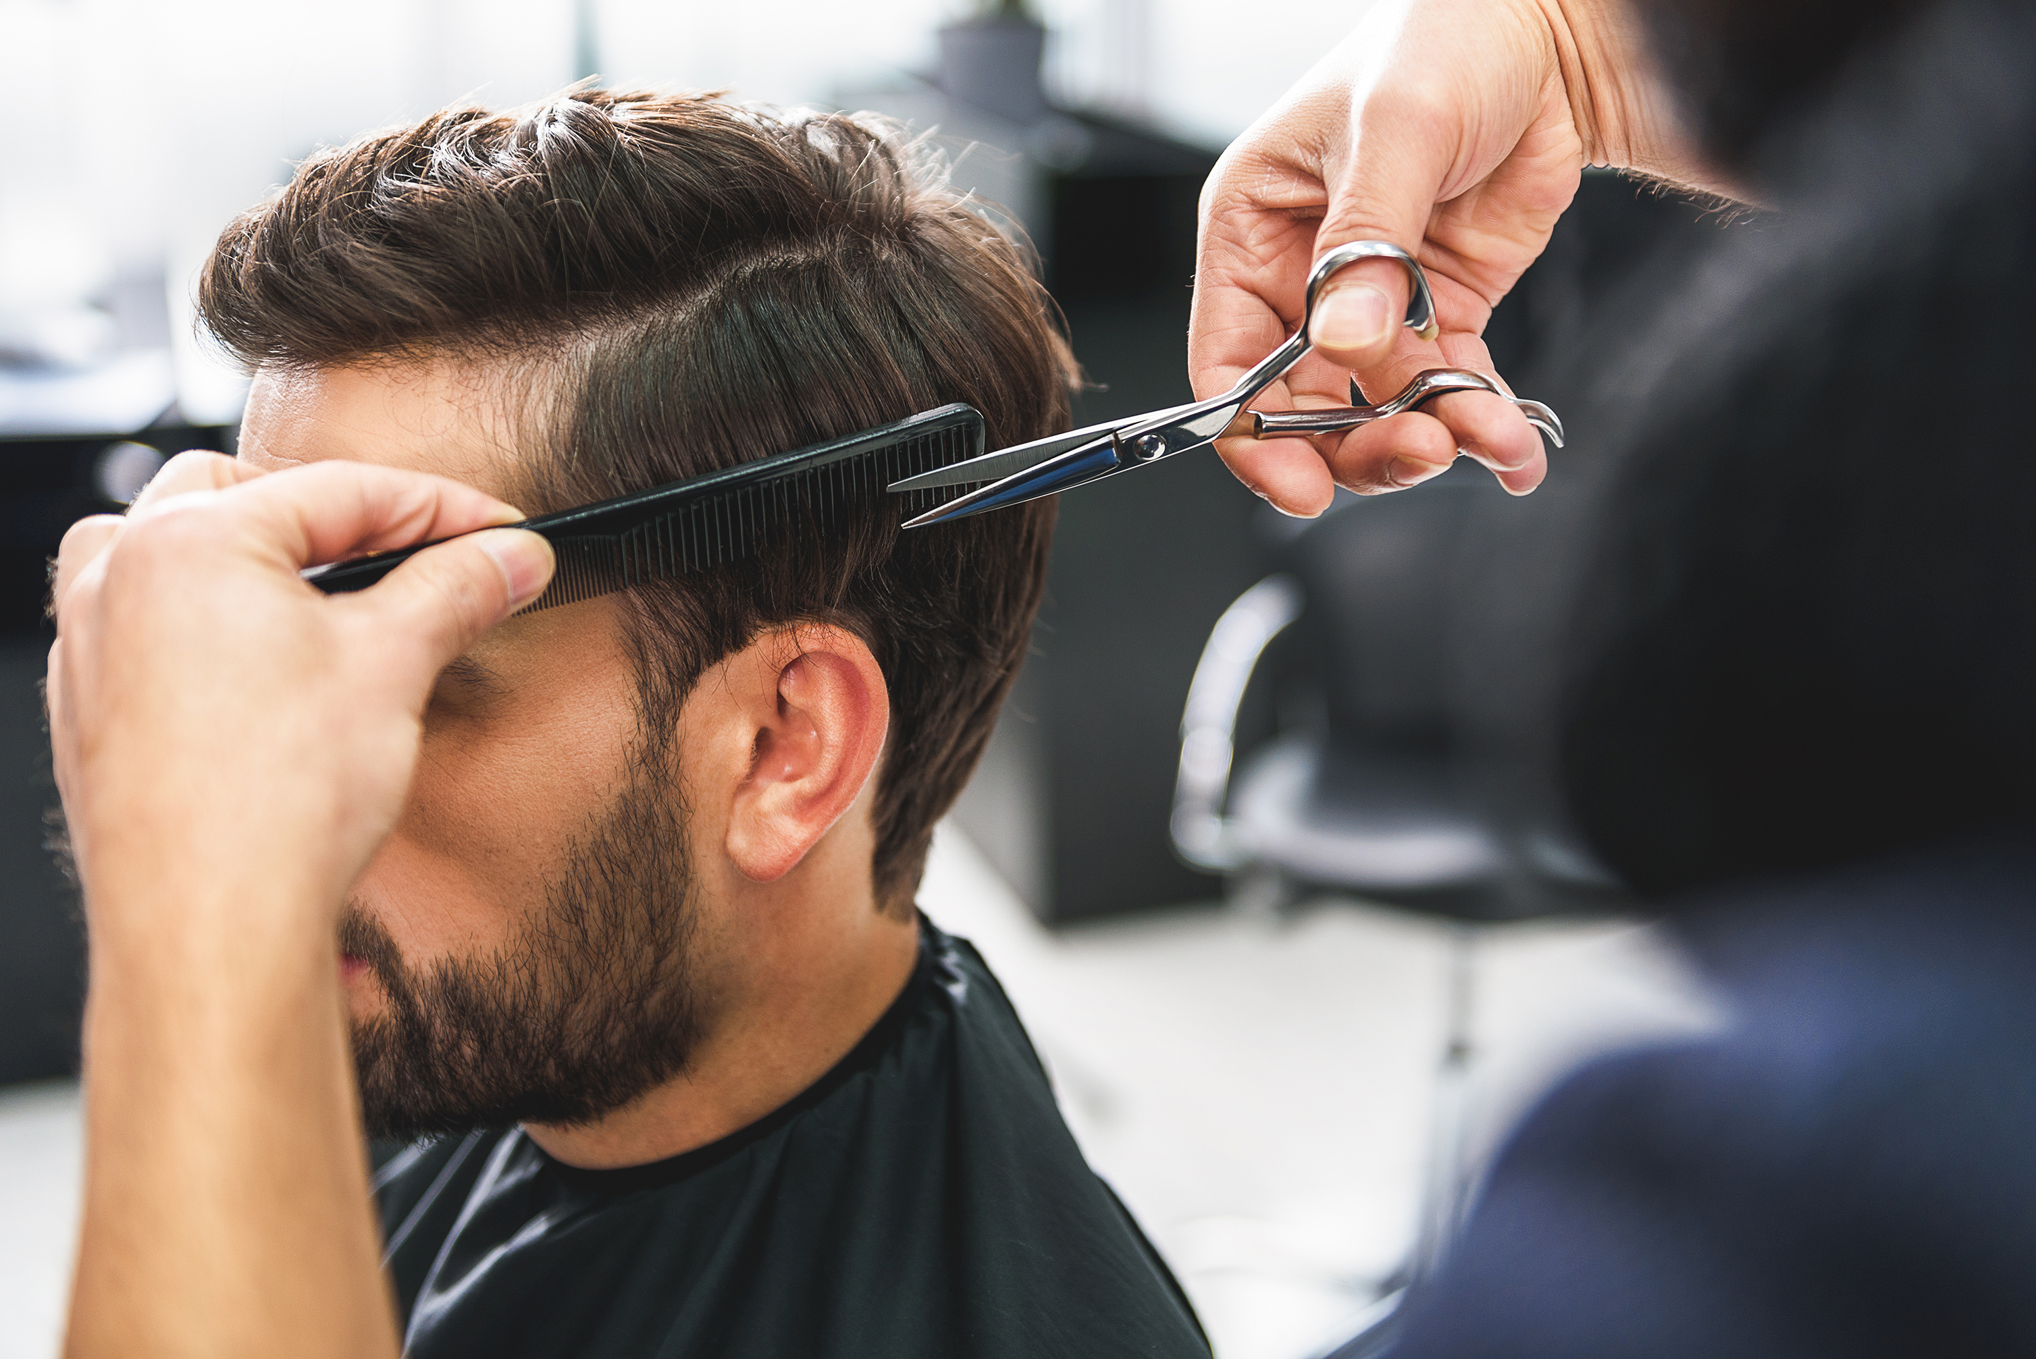

Best Practices for Appearance in IT
Notes:
Appropriate Hairstyles
Maintaining a neat and clean hairstyle is a best practice for IT professionals. As Smith and Doe (2023) note, hairstyles should be professional and not distract from one’s overall appearance. This is important in maintaining a polished image that reflects well on both the individual and the company they represent.
Minimal and Professional Accessories
Using minimal and professional accessories, such as simple jewelry or a classic watch, is recommended in IT. According to IT Career Lab (2018), accessories should complement, not overpower, professional attire. This approach helps maintain focus on one’s professional capabilities rather than their personal style, which is crucial in a technical field where expertise should be the primary focus.

Slide 7

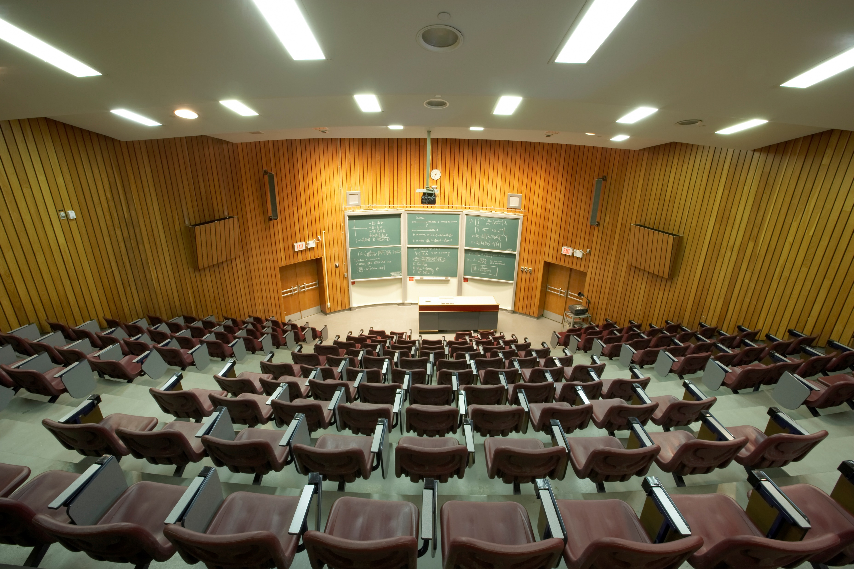
Best Practices for Behavior in IT
Continuous Learning
Notes:
Professional Attitude
The IT profession requires a professional positive attitude, positive body language, and confidence. Smith and Doe (2023) strongly urge this in their work and stress the need for a more informal, friendly environment. Even though they promote less formal interaction among coworkers, they still maintain that working in IT requires a professional (positive) attitude. Stress and the challenges of working in the IT profession require a "go team!" atmosphere for both success and sanity.
Continuous Learning
The continuous learning that IT professionals should adopt as a best practice is reminiscent of two core subjects that my high school teachers taught me: the importance of always staying up to date and the value of technology in this day and age. IT Career Lab (2018) stresses that keeping current with the newest technologies and trends is vital in the fast-paced IT field. The steadfast commitment to fields of study like IT is the very nature of lifelong learning. Skills not enhanced and not kept current will atrophy and become rusty.

Slide 8
References
IT Career Lab. (2018, April 10). What to wear to the IT interview. IT Career Lab. https://www.itcareerlab.org/2018/04/10/what-to-wear-the-it-interview/
Smith, J., & Doe, A. (2023). The impact of professional attire on workplace perceptions. Journal of Occupational Health, 45(2), 123-135. https://www.ncbi.nlm.nih.gov/pmc/articles/PMC9918841/
Microsoft. (2024). [Images]. PowerPoint stock images

