Slide 1


A Historical Perspective and Its Modern-Day Influence
Michael Sullivan
IN250 Unit 4 Assignment
06/28/2024

Slide 2
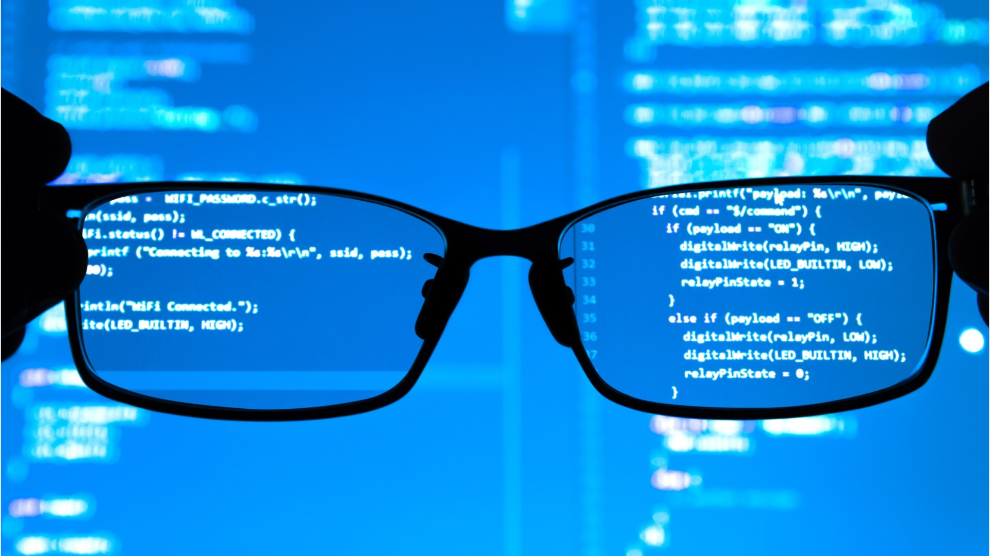
Slide 2 Background on Software Development
Overview: Software development has seen remarkable technological advancements since its early days with the appearance of cumbersome computing machines.
Prominent Figures: Key figures in computing history, for instance, Ada Lovelace, Alan Turing, and John von Neumann, are chiefly responsible for these remarkable developments and, in certain ways, can be considered the pioneers of our age.
Significance: Software development has come a long way since then, and these three historical figures set the foundation for programming as we know it today.
This Photo by Unknown Author is licensed under CC BY

Slide 3
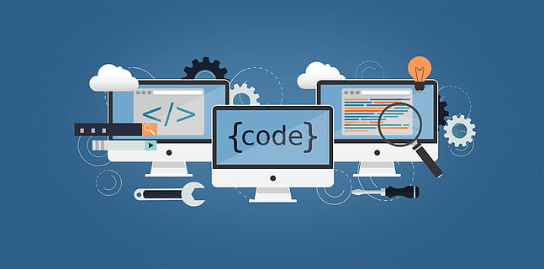
Slide 3
Early Developments and Milestones
Origins of Programming:
Assembly Language: One of the first programming languages, allowing direct interaction with the computer hardware.
Fortran (1950s): A high-level language created for scientific computing, widely adopted by scientists.
COBOL (1959): Developed for business programming, COBOL became the standard in commercial data processing.

Slide 4
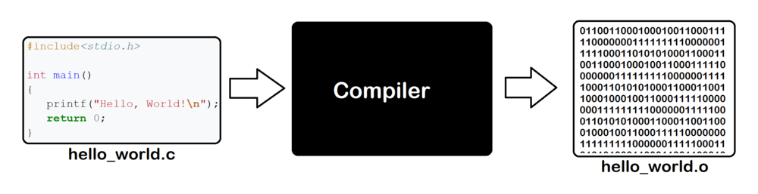
Slide 3 Continued
Key Moments in Software Development:
First Compiler: Created by Grace Hopper, translating high-level language into machine code and simplifying software development.
1960s and 1970s Innovations: The creation of high-level languages like Fortran and COBOL led to significant advancements in software capabilities, establishing foundational methods and tools still used today.
This Photo by Unknown Author is licensed under CC BY-SA

Slide 5
Slide 4
Transition from Procedural to Object-Oriented Programming
Procedural Programming: Procedural programming involves a linear, top-down approach and uses languages like C and Pascal. It focuses on functions or procedures to operate on data.
Object-Oriented Programming: Object-oriented programming uses languages like C++ and Java. It organizes code into objects that contain both data and methods, promoting modularity and reuse.
Impact: The shift to OOP influenced core programming concepts by introducing encapsulation, inheritance, and polymorphism. Repetition and decision structures, arrays/lists, functions, and variables became more modular and easier to manage.

Slide 6
Slide 5
Influence of Historical Aspects on Modern Practices
Repetition Structures: In early programming languages, loops were basic. Today, we use advanced constructs like enhanced for-loops and iterators.
Decision Structures: What began as simple if-else statements has now evolved into complex decision trees and switch-case structures, improving decision-making in code.
Arrays/Lists: Fixed-size arrays were common initially. Now, dynamic data structures like lists offer greater flexibility and efficiency.
Functions and Variables: Encapsulation and modularity have progressed significantly. Modern programming emphasizes reusable functions and well-defined variable scopes.

Slide 7
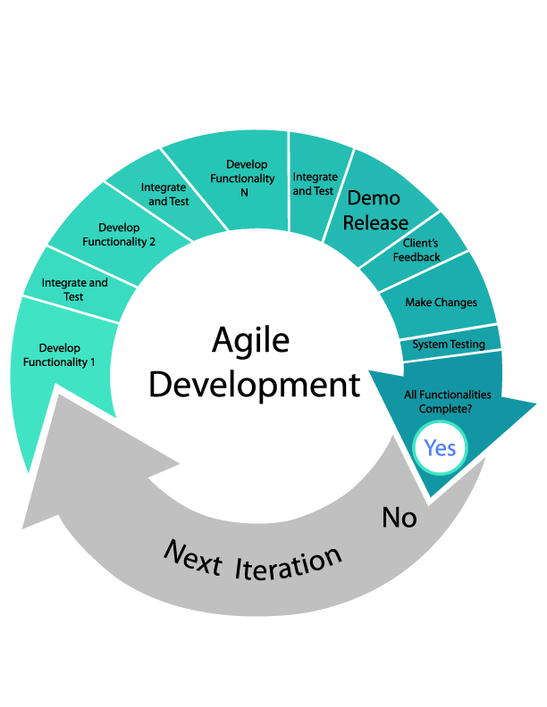

Slide 6
Current Software Development Trends
Agile and DevOps: The Agile and DevOps movements are rapidly shaping how we work. Agile methodologies focus on iterative development and collaboration, while DevOps unifies development with operations and, in many instances, uses processes powered by automation for shipping software.
Cloud Computing: "The cloud means different things to different people. Let’s just say for now that it’s a way of doing business that offers nearly infinite scaling of your architecture as well as lower costs and worldwide infrastructure for your applications.
This Photo by Unknown Author is licensed under CC BY-SA-NC
This Photo by Unknown Author is licensed under CC BY

Slide 8

Slide 6 Continued
Artificial Intelligence and Machine Learning: Having its origins in the field of AI in the 20th century, recent advances in computing power and the proliferation of data have accelerated its use in many fields. There are a few areas of application across industries—from natural language understanding to predictive analytics—that have not or could not be positively affected by AI technology.
Open-Source Movement: Late in the 20th century, open-source software emerged to promote collaborative development, sustain community-driven innovation, and underpin important technologies like Linux and Kubernetes.
This Photo by Unknown Author is licensed under CC BY-SA

Slide 9
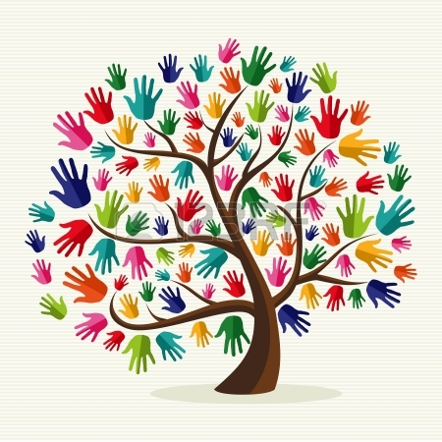
Slide 7
Software Development International Scope and Ethnic Inclusion
Globalization: Globalization has transformed software development into an industry that operates on a worldwide scale. Using distributed teams and forms of international collaboration, we increasingly leverage top talent and global access to markets.
Multicultural Teams: We are finding that the diversity of software teams, including a range of cultures, backgrounds, and life experiences, leads to new levels of growth and innovation for all involved.
This Photo by Unknown Author is licensed under CC BY-NC

Slide 10
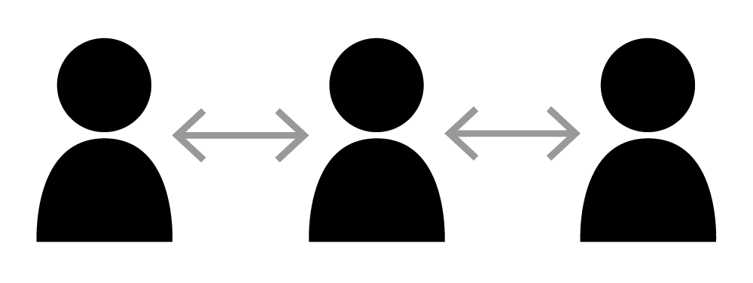
Slide 7 Continued
Challenges and Solutions: Multicultural teams can be challenged by cultural and communication barriers. These two types of barriers can result in a collaboration that is not as productive as it could be and projects that do not reach the heights they might have if each team member were working with real understanding.
This Photo by Unknown Author is licensed under CC BY

Slide 11

Slide 8
Conclusion
To sum everything up, in this presentation, we have gone through many different aspects relating to the past and present in software development. We began our trip with the dawn of computing when programming meant using Assembly language or Fortran. Then we moved software to the next level when we adopted Object-Oriented Programming at the turn of the 21st century.
Continued Influence: Today’s software development trends—Agile, cloud computing, AI, and open-source—have emerged as the leading lights. Each of these historical moments continues to hold sway in current practice. What came before keeps molding what's next.
This Photo by Unknown Author is licensed under CC BY-SA-NC

Slide 12
Slide 9
Bibliography
Hoffmann, Manuel, Frank Nagle, and Yanuo Zhou. "The Value of Open Source Software." Harvard Business School Working Paper, No. 24-038, January 2024.
Obrenović, Ž., & Starčević, D. (2006). Adapting the unified software development process for user interface development. Computer Science and Information Systems, 3(1), 33-52.
Bass, L., Weber, I., & Zhu, L. (2015). DevOps: A software architect's perspective. Addison-Wesley Professional.
Fabrizio Romano. (2018). Learn Python Programming : The No-nonsense, Beginner’s Guide to Programming, Data Science, and Web Development with Python 3.7. Packt Publishing.
Mariano Anaya. (2021). Clean Code in Python : Develop Maintainable and Efficient Code, 2nd Edition. Packt Publishing.

